Slide 1
Introduction
Server side program similar in design and functionality to Java servlet.
Written in HTML rather java programming language.
Converted to a java servlet when client request the jsp.

Slide 2
Lifecycle
jspInt()
service()
jspDestroy()

Slide 3
JSP Tags
JSP program consist of HTML and JSP tags.
JSP tag consist of java code to be executed before output sent to the browser.
Tags are processed by jsp virtual engine

Slide 4
Jsp tags
Comment tag
<%-- --%>
Ex:<%-- Jsp comment --%>
Declaration statement tags:To define variable,object and method
<%! %>
Ex:<%! int i=0 ;%>
Directive tags:To import java packages or file.
<%@ %>
Ex:<%@ page import=“import java.sql.*”; %>
<%@ include file=“keogh\books.html”%>

Slide 5
JSP tags
Expression tag:Used for an expression statement whose result replaces the expression tag.
<%= %>
Scriptlet tags: Commonly used for control and loop statement.
<% %>

Slide 6
Request String
<%! String Firstname =request.getParameter(fname);
String Lastname =request.getParameter(lname);%>

Slide 7
Write JSP program to illustrate the use of , declaration and expression tag

Slide 8
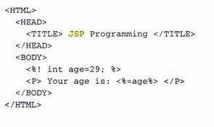

Slide 9
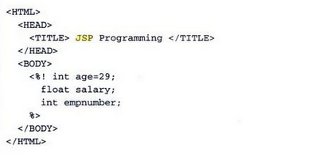

Slide 10
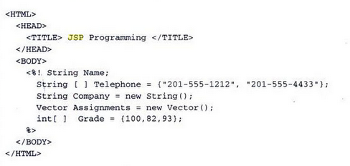

Slide 11
Write JSP program to illustrate writing methods and displaying its outcome.

Slide 12
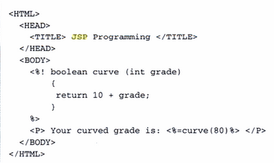
Methods

Slide 13
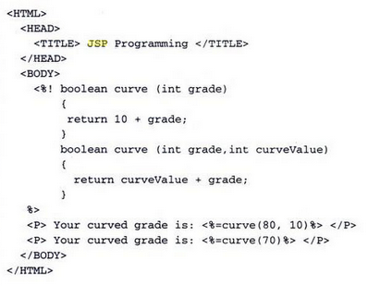

Slide 14
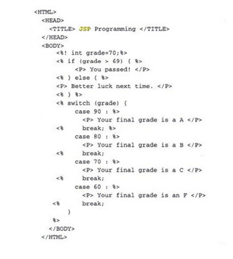

Slide 15
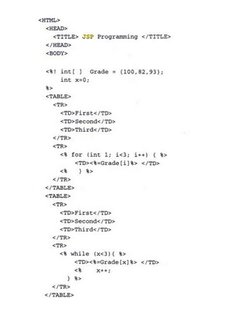

Slide 16
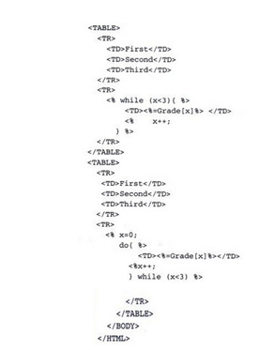

Slide 17
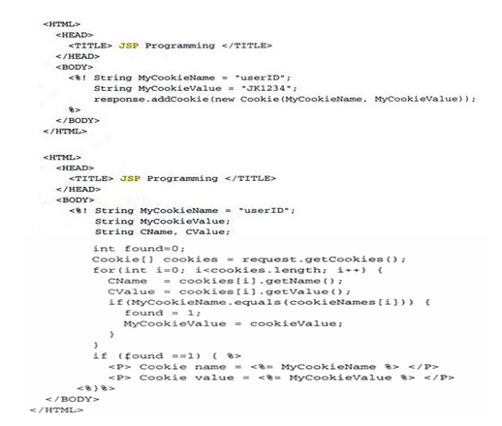

Slide 18
Wite JSP Program to display first Name and Last Name of User.

Slide 19
<%@ page language="java" contentType="text/html"%>
<html>
<body>
<form action="result.jsp" method="GET">
First Name: <input type="text" name="firstname"> <br>
Last Name: <input type="text" name="lastname" /> <input type="submit"
value="Submit" />
</form>
</body>
</html>

Slide 20
<%@ page language="java" contentType="text/html;"%>
<html>
<head>
<title>Using GET and POST Method to Read Form Data</title>
</head>
<body>
<h1>As per your entry </h1>
<ul>
<li><p>
<b>First Name:</b>
<%=request.getParameter("firstname")%>
</p></li>
<li><p>
<b>Last Name:</b>
<%=request.getParameter("lastname")%>
</p></li>
</ul>

Slide 21
<html>
<head>
<title>Echoing HTML Request Parameters</title>
</head>
<body>
<h3>Choose an author:</h3>
<form method="get">
<input type="checkbox" name="author" value=“Herbert"> Herbert
<input type="checkbox" name="author" value=“Navathe"> Navathe
<input type="checkbox" name="author" value=“Peterson"> Peterson
<input type="submit" value="Query">
</form>

Slide 22
<% String[] authors = request.getParameterValues("author");
if (authors != null) {
%>
<h3>You have selected author(s):</h3>
<ul>
<% for (int i = 0; i < authors.length; ++i) {
%>
<li><%= authors[i] %></li>
<%
} %>
</ul>
<a href="<%= request.getRequestURI() %>">BACK</a>
<% } %>
</body>
</html>

Slide 23
Implicit object
1)request: Instance of HttpServletRequest
2)response: Instance of HttpServletResponse
3)Session:Instance of HttpSession
4)Out:Instance of JspWriter

Slide 24
User Sessions
1)Hidden field
2)Cookie
3)Session Objects
4)JavaBean

Slide 25
